Slide 1

Detecting SQL injections using Deep Learning techniques
People's Democratic Republic of Algeria
Ministery of Higher Education and Scientific Research
Ferhat Abbas University of Setif 1
Faculty of Sciences
Computer Science Department
Presented by:
ATHMANI Rami
BOUHEZILA Nassim
IDTW – Master2 Students
Supervised by:
Dr. BENZINE Mehdi
19/06/2023
Notes:
El Salamou alaikom,
We would like to welcome you in our Dessertaion of obtaining our Master2 degree under the title of
Detecting Sql injection …

Slide 2
OUR PRESENTATION PLAN
Introduction
Conception & Implimentation
SQL injection attacks
Model Test & Evaluation
Machine & Deep Learning
Conclusion
Detecting SQL injections using Deep Learning techniques
19/06/2023
Notes:
Our presentation plan covers the stat of art including an overview of Sql injections and Machine learning
After that we will dive on our work including the conception and the implimentaion we set up, followed by Tests and evaluation.
Then A conclusion will end this presentation

Slide 3
STATE OF ART
1
Web apps, sql injections, Machine & Deep Learning

Slide 4

INTRODUCTION
In today's interconnected digital landscape, web applications have become an integral part of our daily lives.
Detecting SQL injections using Deep Learning techniques
19/06/2023
Notes:
As everyone knows, we are in interconnected digital age where Web applications
They enable us to perform a wide range of tasks, from online shopping and banking to social networking and communication

Slide 5
INTRODUCTION
In today's interconnected digital landscape, web applications have become an integral part of our daily lives.
web applications
Detecting SQL injections using Deep Learning techniques
19/06/2023
Notes:
They enable us to perform a wide range of tasks

Slide 6
INTRODUCTION
Facebook Google Youtube Amazone
Netflix Linkedin gitHub openAi twitter
XSS SQL injection
CSRF XXE
BrokenAccessControl
web applications
security threats
Detecting SQL injections using Deep Learning techniques
19/06/2023
Notes:
However, the rise of web applications has also brought about a corresponding increase
in security threats and vulnerabilities like gaining unauthorized access, stealing sensitive information, or disrupting services.

Slide 7
INTRODUCTION
Facebook Google Youtube Amazone
Netflix Linkedin gitHub openAi twitter
XSS SQL injection
CSRF XXE
BrokenAccessControl
SQL injection
web applications
security threats
Detecting SQL injections using Deep Learning techniques
19/06/2023
Notes:
We will focus on this work on Sql injection attacks

Slide 8
SQL INJECTIONS
SQL injection
Def:
insertion or “injection” of a malicious SQL query via the input data from the client to the application.
Detecting SQL injections using Deep Learning techniques
19/06/2023

Slide 9
SQL INJECTIONS Process
Detecting SQL injections using Deep Learning techniques
19/06/2023
Notes:
Basically, SQL injection process is structured in Four (4) phases:
The attacker sends the malicious HTTP request to the web application
The malicious code concatenated with the developer’s SQL statement
The system submits the SQL statement to the backend database.
The Database system returns the sensitive data for the Attacker to be exploited after.
As shown in this Figure ‎that describes a login by a malicious user exploiting SQL Injection vulnerability. The Administrator will be authenticated on the application after typing: employee id=112 and password=admin. The attacker is trying to find a SQL injection vulnerability to log in to the application by adding a tautology to the developer’s SQL statement.

Slide 10
SQL INJECTIONS Techniques
Using Tautologies (Ex: ' OR '1'='1')
Error-based SQL injection
Blind SQL injection
Union-based SQL injections
Detecting SQL injections using Deep Learning techniques
19/06/2023
Notes:
Tautologies : Injects SQL tokens into the conditional query statement to be evaluated as always true.
Error Based sql injection : Use SQL queries that trigger errors in order to learn about the structure and contents of a database.
Blind sql injection: Asks the database true or false questions and determines the answer based on the application’s response.
Union Based SQl injections: Used in SQL to combine the results of two or more SELECT statements into a single result set.

Slide 11
SQL INJECTIONS Defense
Escaping
Use always character-escaping functions for user supplied input.
Input validation
Verify whether or not the type, length, format,.. of input submitted by a user is allowed.
Detecting SQL injections using Deep Learning techniques
19/06/2023
Notes:
Many Defense techniques exists in the field to prevent sql injections like :

Slide 12
SQL INJECTIONS Defense
Parameterized queries
Pre-compiling an SQL statement so that the developer can supply the parameters for the statement to be executed.
Web application firewalls (WAF)
A WAF will keep monitoring the recieved applications requests (POS/GET) receives to find and block malicious traffic .
Detecting SQL injections using Deep Learning techniques
19/06/2023
Notes:
More on that, the techniques of defence arrives to the use of machine learning

Slide 13
SQL INJECTIONS Defense
Detection using machine learning
Rapidly scan vast amounts of incoming queries
Flagging potential threats in real-time by automating the process of query analysis and classification.
Detecting SQL injections using Deep Learning techniques
19/06/2023
Notes:
Using machine-learning algorithms that are commonly used for binary classification tasks
Dataset Preparation, Feature Extraction, Dataset Splitting, and Model Training must be followed to train a model .
Other Defense techniques has been prouve their results in the field are Deep Learning architecturs

Slide 14
MACHINE LEARNING & DEEP LEARNING
2
Supervised learning, Unsupervised learning, CNN, Transformer.
Detecting SQL injections using Deep Learning techniques
19/06/2023

Slide 15
MACHINE LEARNING
Artificial Intelligence (AI)
A field of computer science that aims to create intelligent systems capable of performing tasks that typically require human intelligence.
SelfDrivingcars VoiceAssistants ChatBots ...
Detecting SQL injections using Deep Learning techniques
19/06/2023
Notes:
From self driving cars to voice assistants
Ai has made remarkable strides
transforming the way we live, work,
and interaction with technology

Slide 16
Machine Learning
Ai
Machine Learning
  A subset of AI.
  Focuses on developing algorithms
and models capable of enabling computers
to learn and make predictions based on data
without explicit programming.
Machine Learning
Deep Learning
Detecting SQL injections using Deep Learning techniques
19/06/2023

Slide 17
Machine Learning Types
ML Types
Supervised learning.
Unsupervised learning.
Reinforcement learning.
Detecting SQL injections using Deep Learning techniques
19/06/2023
Notes:
Machine Learning can be categorized into three main types:

Slide 18
Machine Learning Types
Supervised learning
Training machine learning models on labeled data.
Target:
      Classification problems
      Regression problems.
Algorithms:
Linear Regression, Decision Trees, SVMs,..
Detecting SQL injections using Deep Learning techniques
19/06/2023
Notes:
Envloves

Slide 19
Machine Learning Types
Unsupervised learning
Training machine learning models on Unlabeled data.
Algorithms:
K-means clustering, PCA,...
Detecting SQL injections using Deep Learning techniques
19/06/2023
Notes:
Envloves

Slide 20
Machine Learning Types
Reinforcement learning
Training agents to interact with an environment and learn optimal behaviors through trial and error.
Algorithms:
Q-learning, deep Q-networks...
Detecting SQL injections using Deep Learning techniques
19/06/2023
Notes:
Envloves

Slide 21

Deep Learning
Ai
Deep Learning
  A subset of ML.
  Uses multilayer artificial neural
  networks to model and solve complex
  problems.
  These neurons are designed to simulate the
  neurons of the humain brain.
Machine Learning
Deep Learning
Detecting SQL injections using Deep Learning techniques
19/06/2023

Slide 22
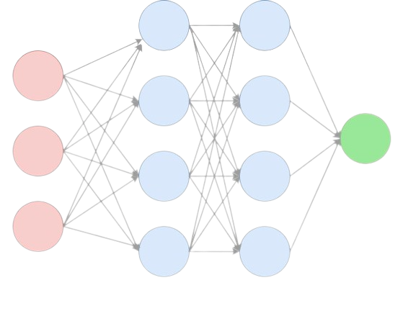
Deep Learning
ANNs are generally composed of many layers, including an input layer, one or more hidden layers, and an output layer.
Detecting SQL injections using Deep Learning techniques
19/06/2023

Slide 23
Deep Learning Architectures
Some of the most popular Architectures are :
CNN (Convolutional Neural Network)
RNN (Recurrent Neural Network)
LSTM (Long Short-Term Memory)
TRANSFORMERS
Detecting SQL injections using Deep Learning techniques
19/06/2023
Notes:
CCN:A type of neural network architecture designed for image processing tasks.
RNN:A type of neural network architecture commonly used for processing sequential data, such as text or speech.
LSTM:An improved version of RNN that can capture long-term dependencies
TRANSFORMERS:A neural network architecture that uses self-attention mechanisms

Slide 24
Conception & Implimentation
3
Conception, BERT, Dataset, Code & Hyperparameters
Detecting SQL injections using Deep Learning techniques
19/06/2023

Slide 25
CONCEPTION & IMPLIMENTATION
SQL injection attacks represent a major risk for applications interacting with databases.
Detecting SQL injections using Deep Learning techniques
19/06/2023
Notes:
The threat of sql injections attack ….

Slide 26
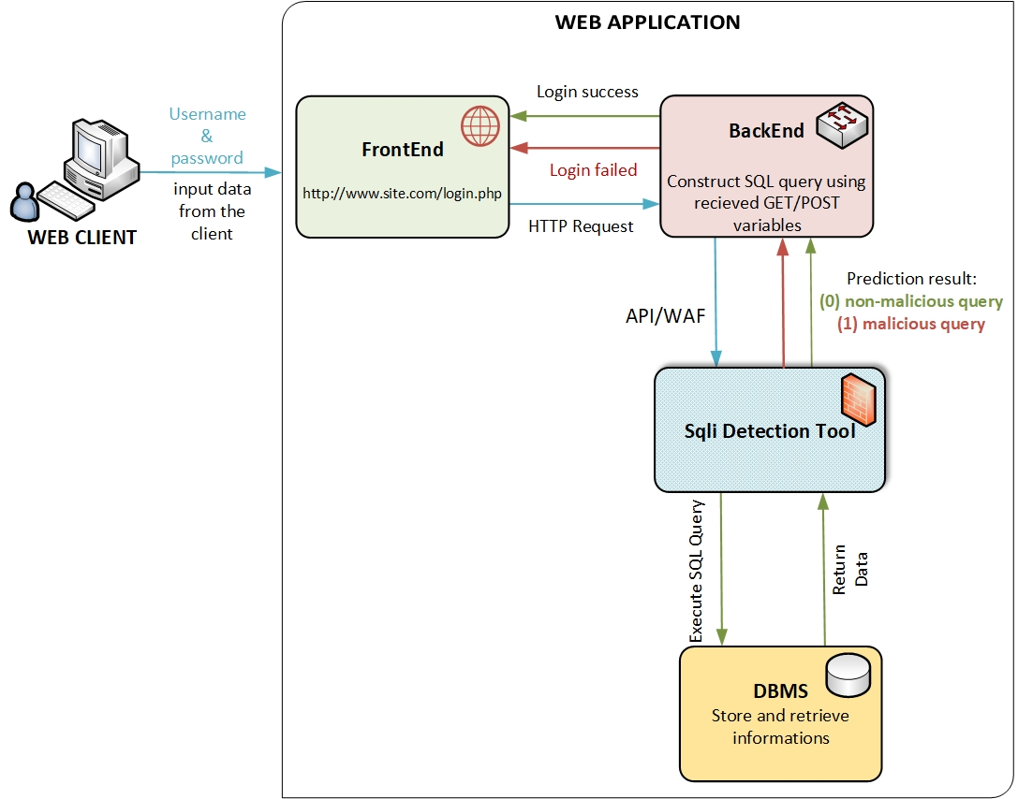
CONCEPTION & IMPLIMENTATION Solution Architecture
Detecting SQL injections using Deep Learning techniques
19/06/2023
Notes:
As a solution for this problem, we had built a Deep Learning Model
Capable of detecting SQL injections that can be used as an API or WAF tool.
The general conception of our solution is as follow:
The Web client that can act also as an attacker send data to the Backend Tier throw the forms input filed.
Befor the Execution of the query that has been constructd by the recived GET / POST variables, it passe throw our detecting tool (model) for analysing.
Once the SQL injection is detected, the tool can either block the request or alert the system administrator, depending on the configuration.
In the other sinario, if the request is a non malicios query, it passes to the DBMS and executed as normal situation

Slide 27
IMPLEMENTATION PIPELINE
Data Acquisition
Train the DL Model
1
3
START
STOP
2
4
Data PreProcessing
Model Evaluation
Notes:
At the start we red about the problem of sql injections and start searching for a good dataset.
When we found the Dataset, we analysed and Preprocessed it to be ready for our model.
As a 3rd step we Fine Tuned our Model using the best HyperParameters values.
Then we Evaluate our Model and testes it on Unseen Dataset to analyse it’s oerformance.
At Last we saved our Fine tuned Model to be used later as a tool

Slide 28
CONCEPTION & IMPLIMENTATION Chosen model
Bidirectional
Encoder
Representations
Transformers
Takes into account each word by using a bidirectional approche.
Learns to generate high quality words representations that encode rich semantic informations.
The pre-trained representations can be fine-tuned on specific tasks.
Detecting SQL injections using Deep Learning techniques
19/06/2023
Notes:
The chosen model for our solution of detecting sql injections Using deep learning is bert (beeeeert)
Bert is based on transformer architecture , unlike traditional models that process text sequentially , bert takes into account the entire context surounding each word by using a bidirectional approach.

Slide 29
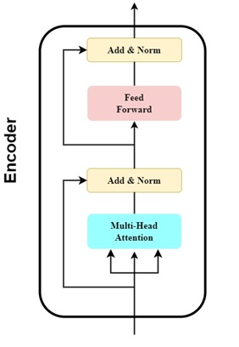
CONCEPTION & IMPLIMENTATION BERT
Detecting SQL injections using Deep Learning techniques
19/06/2023
Notes:
in it’s original form the transformer consists of two componants : and encoder and a decoder , however , since Bert’s objective is to generate a language model only the encoder in necessary .
THE encoder in BERT is made up of 6 identical layers , each layer consists of two sub layers ,
the first sub layer is a multi head self attention mechanism , which employs multiple attention heads to capture dependencies between words and sub words .
The second sub layer is a feed forwar network wich processes the outputs from the previous self-attention layer.
Both sub layers are followed by a normalization layer.
To use bert on a classification task a simple soft max classifier is added on top of BERT.

Slide 30
CONCEPTION & IMPLIMENTATION Dataset
Found: "SQL Injection Dataset" list on the Kaggle platform.
  SQLiV2.csv (3.61 MB) contains 33726 samples with :
  66% classified as normal queries .
  34% as malicious queries.
  SQLiV3.csv (2.32 MB) contains 30873 samples with :
  62% classified as normal queries .
  37% as malicious queries and 1% as other.
Detecting SQL injections using Deep Learning techniques
19/06/2023
Notes:
We needed to find a Dataset consisting of samples divided into two classes: "malicious queries"
and "non-malicious queries".
We found a list of datasets on the Kaggle platform. that were created by “Syed Hussain” that contain Three (03) versions:
We ignored the first one because of it’s small size

Slide 31
CONCEPTION & IMPLIMENTATION Dataset
  SQLiV2.csv (3.61 MB) contains 33726
Issue: No normal queries in the dataset, only free text in place flagged as normal queries.
Detecting SQL injections using Deep Learning techniques
19/06/2023
Notes:
At first vision we choose the SQLiV2 Dataset because of the size of samples in it in comparison to others,
we trained our model with it in the first time but unfortunately, the results were not satisfied while predicting normal queries.
After analyzing the situation, we found that there were no normal queries in the dataset, only free text in place flagged as normal queries.

Slide 32
CONCEPTION & IMPLIMENTATION Dataset
  SQLiV3.csv (2.32 MB) contains 30873
PreProcessing:
  Remove any unnecessary Strings or characters in the SQL statements.
  Remove not valid empty columns.
  Remove empty and free text Rows.
  Remove wrong SQL queries.
Detecting SQL injections using Deep Learning techniques
19/06/2023
Notes:
Then we tried the SQLiV3.csv Dataset that contain both malicious and non malicious queries, but we identified certain deficiencies that need to be cleared using some preprocessing steps like:

Slide 33
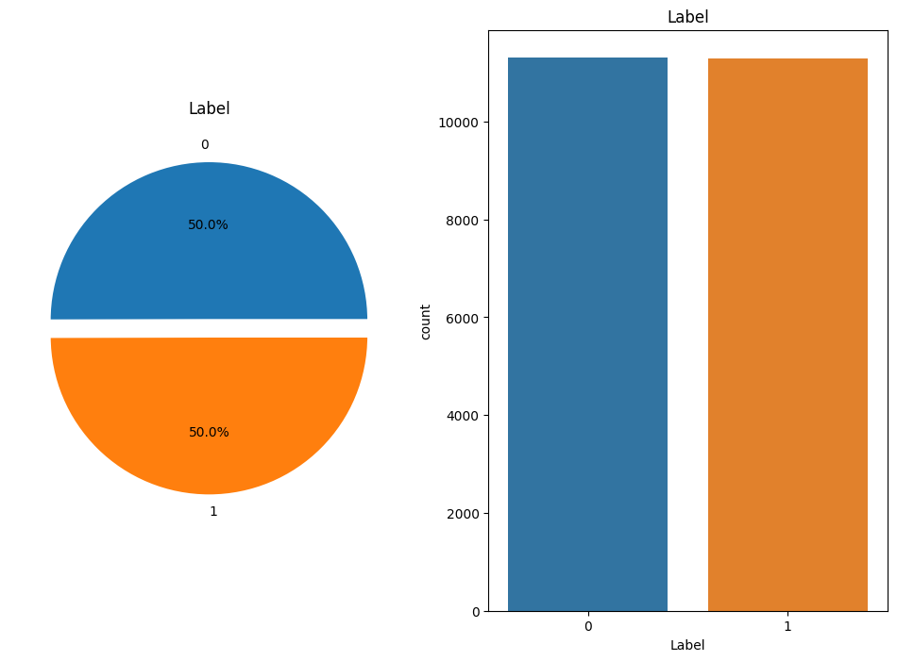
CONCEPTION & IMPLIMENTATION Dataset
11308 (≈50%)
"non-malicious".
11291 (≈ 50%)
"malicious queries".
Detecting SQL injections using Deep Learning techniques
19/06/2023
Notes:
After clearing the different deficiencies, we came up with a new valid preprocessed
Valide Dataset (1.97 MB) contains
22599 samples:
11308 (≈ 50%) "non-malicious".
11291 (≈ 50%) "malicious queries".
Dataset that has sufficient diversity in both categories and is ready to be used in the next step

Slide 34
CONCEPTION & IMPLIMENTATION Code & HyperParameters
Splitting & preProcess data for BERT
sentences = df['Sentence'].tolist()
labels = df['Label'].tolist()
(x_train, y_train), (x_test, y_test), preproc =
text.texts_from_array(sentences, labels, preprocess_mode='bert',
maxlen=100, val_pct=0.2, class_names=list(set(labels))
)
Detecting SQL injections using Deep Learning techniques
19/06/2023
Notes:
For the fine-tunning of a preTrained BERT Model on our task, we uses the Ktrain library Of Python.
The code shows the method text_from_array from the ktrains library that we use to convert the data into arrays that can be used for fine tunning the pre-trained bert model
We set The preprocess_mode parameter to ‘bert’ which means that the data will be preprocessed according to the requirements of bert .
The validation percentage is set to 0.2 wich means that 20% of the data will be used for validation
The max length is set to 100 meaning that the maximum lengh of a sentence is set to 100 token.

Slide 35
CONCEPTION & IMPLIMENTATION Code & HyperParameters
Build the BERT model
model = text.text_classifier('bert', (x_train, y_train), preproc=preproc)
Detecting SQL injections using Deep Learning techniques
19/06/2023
Notes:
In this code line a bert model in being built using the text_classifier function , this method takes the name of the model , the training data and the preprocessing object as input.

Slide 36
CONCEPTION & IMPLIMENTATION Code & HyperParameters
Fine-tuning BERT model
learner = ktrain.get_learner(model=model,
train_data=(x_train, y_train),
val_data=(x_test, y_test),
batch_size=32)
learner.fit_onecycle(lr=2e-5, epochs=4)
Detecting SQL injections using Deep Learning techniques
19/06/2023
Notes:
The model Is fine tuned using ktrains get_learner method and one_cycle policy
First the get learner method creats a learner object for the model and the training data
Then the fit one cycle method is called on the learner object to fine tune the model on a specified learning rate value that was recomanded by google for fine tuning bert and 4 epochs.

Slide 37
CONCEPTION & IMPLIMENTATION Code & HyperParameters
Make Predictions
predictor = ktrain.get_predictor(learner.model, preproc)
# make predictions
samples = [
"1'; DROP TABLE users;--",
"UPDATE customers SET phone_number = '555-555-5555' WHERE name = 'John Doe'",
"SELECT COUNT(*) FROM users WHERE username = 'admin' OR 1 = 1",
"UPDATE users SET password = 'newpassword' WHERE username = 'admin'"
]
prediction = predictor.predict(samples)
Detecting SQL injections using Deep Learning techniques
19/06/2023
Notes:
The get predictor method loads the fine tuned model to create a predictor object , then the object is used with the predict function to make predictions.

Slide 38
Test & Evaluation
4
Confusion matrix, Evaluation metrics, Model performance
Detecting SQL injections using Deep Learning techniques
19/06/2023
Notes:
We assess the model's performance using a variety of evaluation metrics, including accuracy, precision, recall, F1 score,

Slide 39
TEST & EVALUATIONS
Validation Confusion matrix
 | Positive Prediction | Negative Prediction
Positive Class | 2251 | 1
Negative Class | 0 | 2268
Detecting SQL injections using Deep Learning techniques
19/06/2023
Notes:
The confusion matrix reveals that out of the 2252 positive instances (normal queries), the model correctly identified 2251 instances as positive (true positives) while misclassifying one instance as negative (false negatives). It also correctly classified 2268 out of 2268 negative instances as negative (SQL injections).

Slide 40
TEST & EVALUATIONS
Evaluation metrics
Accuracy 99.98%
F1 Score 99.98%
Precision 100%
Recall 99.96%.
Detecting SQL injections using Deep Learning techniques
19/06/2023
Notes:
The performance results obtained are as follows:
These results are consistent with the findings of Srishti Lodha and Atharva Gundawar from the Department of Computer Science and Engineering at Vellore Institute of Technology [30], who made a similar study using the BERT architecture for SQL injection detection.
Both of our research demonstrated comparable performance and highlighted the effectiveness of the BERT model in accurately identifying SQL injection attacks.

Slide 41
TEST & EVALUATIONS
Comparative analysis with other approaches
Model name | Training Accuracy | Validation Accuracy | Precision | Recall | F1
KNN | 100 | 99.12 | 98.85 | 99.52 | 99.18
SVM | 92.78 | 92.44 | 90.21 | 96.36 | 93.19
BERT (our model) | 100 | 99.98 | 100 | 99.96 | 99.98
Detecting SQL injections using Deep Learning techniques
19/06/2023
Notes:
The compared approaches were trained on a dataset of approximately 42,000 data points, while our dataset consisted of 22,599 samples. This disparity arises from the fact that we obtained the original dataset from the same resource, but we had to perform data cleaning and preprocessing to ensure its quality.
The comparison shows that BERT (Our model) performed the best among the compared models in terms of key evaluation metrics, including accuracy, precision, recall, and F1 score. These results affirm the effectiveness of BERT in detecting SQL injection attacks, highlighting its superior performance in our study.

Slide 42
TEST & EVALUATIONS
Test Confusion matrix
 | Positive Prediction | Negative Prediction
Positive Class | 10 | 0
Negative Class | 0 | 10
Detecting SQL injections using Deep Learning techniques
19/06/2023
Notes:
In the testing phase on new unseen data, the model was evaluated using a sample of 20 instances.
The model correctly identified and classified all 20 samples, achieving a remarkable accuracy rate of 100%.

Slide 43

Conclusion
The primary contribution of our work lies in demonstrating the effectiveness of BERT in accurately identifying SQL injections.
Our work has certain limitations that should be admitted such as the dataset used for training and evaluation that may not be large enough to fully exploit the potential of BERT.
Detecting SQL injections using Deep Learning techniques
19/06/2023

Slide 44
Conclusion Recommendations
Explore a larger and more diverse dataset.
Investigate the model's performance in real-world scenarios.
Continuously update the model with new attack patterns.
Expand the scope to detect and classify various types of cyber attacks.
Detecting SQL injections using Deep Learning techniques
19/06/2023

Slide 45
Thanks!
ANY QUESTIONS?
Detecting SQL injections using Deep Learning techniques
19/06/2023

